Slide 1
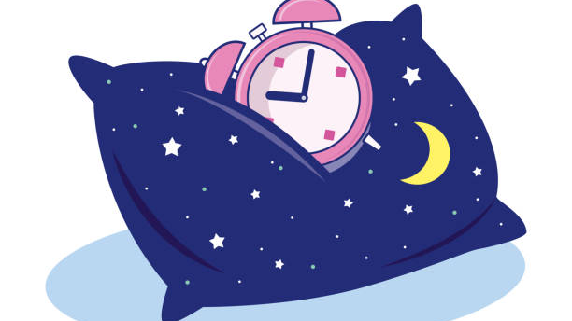

Bedtime Routines

Slide 2

Bedtime Routines Creating a unique routine that fits in with your family continuously , is key for success. If your child knows they can change the routine to suit their preferences, or you alter from the routine even just once, it will reduce the success. Plan and discuss the routine as a family so, everyone knows exactly what will happen and come next. This will help to create a calm and worry-free routine and allow a buy in from all. Write down any key problems that arise such as: getting out of bed, scared of the dark, saying they are not tired etc. Plan a time, which is not at bedtime, to talk about those worries. Some families call it the ‘worry hour’. This is an allocated time to talk through worries and problem solve ideas together.
LET’s GET Started…

Slide 3

Why is sleep so important?
Why Is Sleep Important for Children?
Children feel the effects of poor sleep just like adults do.
Tired children may not say they are tired, they show it through their behaviour.
Lack of sleep can affect learning, emotions and even friendships.
Tiredness often shows more at the end of the school day which can lead to signs of dysregulation.
Effects of Poor Sleep
Difficulty regulating emotions.
Reduced academic progress.
Impulsive and unpredictable behaviour.
Reduced attention span.
Reduced growth and brain development.

Slide 4

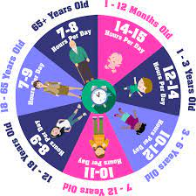
What time do you begin the routine?
It is always best to give you child a prewarning that their games/ TV/play etc is coming to an end. 10 minutes before we start bedtime jobs, 5 minutes before we start bedtime jobs, now its time for bedtime jobs. For younger children you could use a visual timer or use simplified language such as soon, next, now.
What time you want your child in bed, is a family’s personal choice.
More information can be found here: Sleep and your pre-schooler - Harrogate and District NHS Foundation Trust
Your routine could take 30 mins to an hour depending on what you want to include in your bedtime routine.
The NHS guidance's recommends:

Slide 5
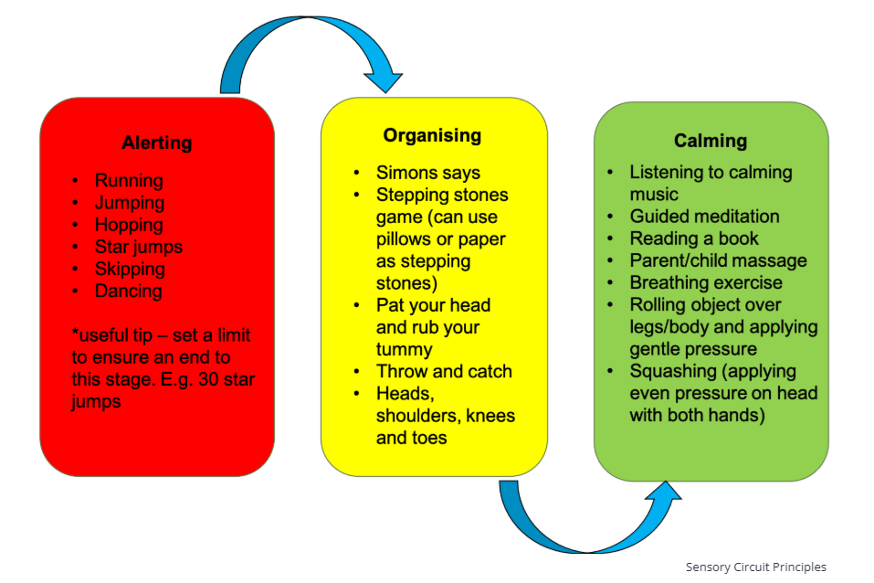
Release the energy!
Some children have a lot of built-up energy and need to release it, especially after eating their tea. If they have been sat watching TV or doing something static; sitting/laying they may not be ready to just go and lie down in bed.
Children with a lot of energy may need to tire themselves out before attempting to go to bed. A good way to do this is through a sensory circuit.
Follow the 3-step flow chart and pick one from each section.

Slide 6

Calm time
If your child has just completed a sensory circuit, they will now be ready for quiet down-time. Away from blue light, not competitive and not over stimulating.
Switching off blue light is really important as blue light promotes alertness and performance, by suppressing melatonin, which is what is needed to promote sleepiness. It is advised that devices such as tablets, phones even some LED lights need to be turned off- ideally 1 hour before sleep.
Daytime blue light is ok but at nighttime it tricks the brain not to produce the melatonin.
Ideas for quiet down-time in the evening, before getting into the bath or bed:
Jigsaws or similar puzzles
Colouring/ drawing
Sensory play –playdough, sand, bubbles, aqauabeads etc
Rocking/ gentle swinging
Writing (if they enjoy this)
Knitting/sewing/crafting –keep it simple and calm
What they find relaxing and you feel is appropriate

Slide 7

Bath and Pj’s
Bath duration, timings and top tips!
Some children bath/shower every night, some every other, day and others 2-3 times per week. There are lots of “bedtime” bubble baths available and lavender essences you can add, to create a calming relaxing atmosphere.
Aim for a short, warm bath , around 5-20mins long to avoid over stimulating or drying out skin.
Schedule a bath 30-60minutes before the desired bedtime to allow for the body’s natural temperature to drop which promotes sleepiness.
Once in Pj’s, make it the rule, that now everyone’s voice-volume is decreased.
Establish that this is the right time for a last drink of water and toilet. Let them know once in bed that is where they stay. So, encourage them to try on the toilet before going into bed.

Slide 8

Into bed, who is ready for a story?
Story:
Use this time to share their favourite story.
Why not make up a story, with your child being the main character, could they help to tell you a story?
Make this time special, so they look forward to it everyday.

Slide 9
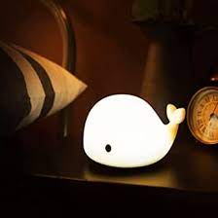
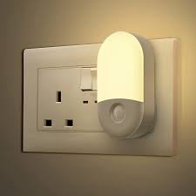

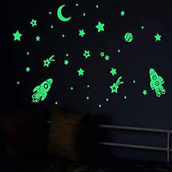
Night light or timer on lamp
You can find a variety of night lights options on the market nowadays such as: plug in’s, simple lamps, glow in the dark stickers, low glow, night projector a glowing teddy etc.
If this helps your child to feel safe at night that’s great but, just ensure it is not LED blue light or too bright that it is distracting to sleep.
Some families leave the landing light on and the door ajar instead.
Night light displays with stars and patterns, projectors are not just for babies/toddlers, they suit some children who like that sensory feedback to feel at ease. It could be as simple as glow in the dark star stickers on the ceiling.

Slide 10



The sound of silence
Some children do not like the silence that bedtime brings. Sometimes, they can hear the creaks and noises of the house. Whether it is the pipes or other people moving around, their imagination can sometimes make it into something scary.
Some children are comforted by listening to soothing sounds, quiet lulling music, sound of nature like a waterfalls or the sea or a sleep story. Find what works for your child.
YouTube have an array of different audios that can be 10hours long and so even if your child woke during the night they would be comforted back to sleep.
10 Hours Of Sleeping Music For Kids | Unicorn's Dream - YouTube
FALL INTO SLEEP INSTANTLY ★︎ Relaxing Music to Reduce Anxiety and Help You Sleep ★︎ Meditation – YouTube
Hot Air Balloon Ride: A Guided meditation for Kids, Children's Visualization For Sleep & Dreaming - YouTube

Slide 11
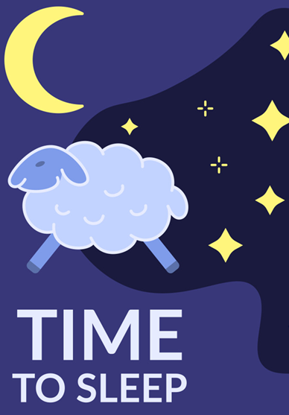
Goodnight, lights out.
Now it is time to say goodnight.
You will have already gone through the bedtime routine and your child is now ready to sleep. The next part might look something like this: a kiss, a hug, say goodnight and put on the bedtime light/sounds on.
Remember to keep your language simple “bedtime now, goodnight”.
If they get out of bed, lead them back to the bed calmly, simply say “bedtime now” and put them back in bed.
Remember to use a calm whispering voice every time.
Try to avoid additional drinks.
If they say they need the toilet, let them go, but no engagement.
Although it may take a few attempts, persevere. Every night, it will become a little easier.

Slide 12
Any Questions???
This has been made to support our families little ones to have a healthy bedtime routine to ensure your child is well rested and ready for the fun day ahead.
01
If any of our families would like any further support around bedtime routines, please do get in touch with our SENCo Mrs Hawkes, our Pastoral Advisor Mrs Burton or Mrs Dennis from our Wellbeing In Mind Team Representative.
02

Slide 13
Useful Website links
Children and Sleep | Sleep Foundation
Sleep Advice Service – Cerebra (recommend the Sleep booklet to download)
BBC Sounds - Sleepy Stories - Available Episodes
Beautiful Sleep Music for Kids 💜Nap Music Deep Sleep | Calming & Soothing Bedtime Music – YouTube
Sleep and your pre-schooler - Harrogate and District NHS Foundation Trust
Our Courses - The Sleep Charity

