Slide 1

Morning Routines

Slide 2


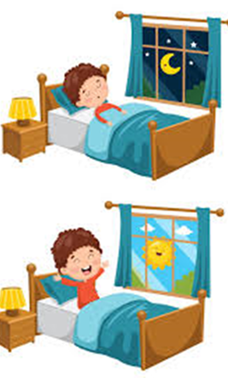

Bedtime Routine:
Firstly, ensure you have followed your good bedtime routine so that your child has had enough sleep.
Remember, broadly, children need;
3-6 years: 10-12 hours sleep
7-12 years: 10-11 hours sleep
A good morning routine will be easier with the more sleep your child has had.

Slide 3
Evening Preparation:
To avoid the morning stress of searching for items when you need to leave the house, a good tip is to prepare everything the evening before.
School clothes, out in a pile ready to put on the next day.
School bag, prepacked with everything needed for the day- books, drink etc.
Shoes and coat by the door with the bag.
Packed lunch (if they have one), ready in the fridge the night before.
A visual or word tick list of everything you need to check off before you set off.

Slide 4
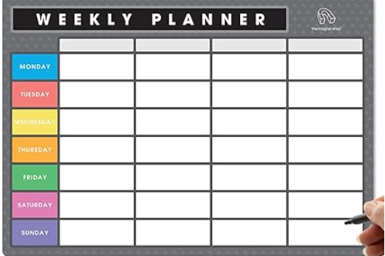
Weekly Planner
A lot of avoidable issues arise on a morning when you suddenly remember it is a PE or swimming day or they need to bring in a chocolate tombola donation.
Having a weekly family planner can help assist with this.
Top tip! Use the school weekly newsletter to write the week’s activities, including PE days, clubs, school events or library days. Then use this on the evening when helping your child to pack their bag which will help to avoid last minute surprises!

Slide 5
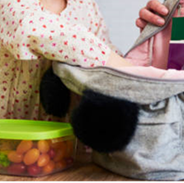
Children’s responsibility too
Make sure your child helps you do the evening prep, point out to them what the next day involves.
Ask them to lay their clothes out but watch and check.
Look on the weekly planner together, get them into the routine of knowing that they might need to bring back their library book on a Wednesday etc. They are never too young to learn.
This will train them up to doing it themselves, especially in KS2 and certainly in preparation for secondary school.
This also assists them in knowing what is in their bag, so if a teacher says: “have you got your reading folder?”, they can confidently say “Yes I put it in last night”.

Slide 6

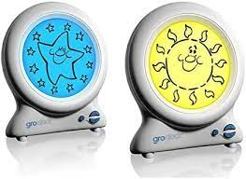
Getting up
Gro clocks can help you children to understand when it is time for sleep and when it is time to wake up.
For older children, setting an alarm clock is useful so children can hear when it is time to get up.
When it is time to get up, support your child by opening their curtains and put the light on. This way they won’t be tempted to fall back asleep.

Slide 7
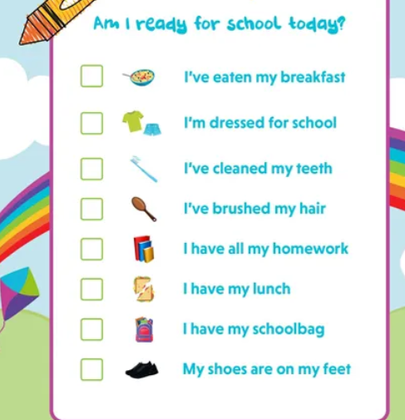
Morning Visual Timetable
            Like the bedtime routine, some children like to follow a visual timetable to help manage their time and what is expected of them.
            Your routine may be in a different order, but it needs to be clear, as time is important on a morning and we don’t want anyone missing breakfast because they are late.
            You can create one using pictures, drawings or even just a list to follow.

Slide 8
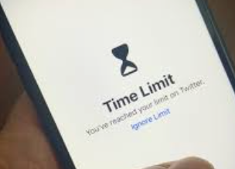
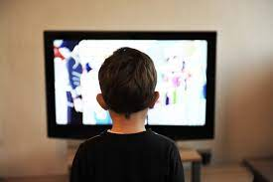
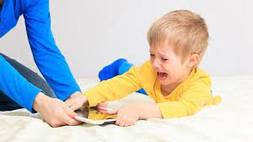
TV and distractions:
There is always a time and a place for screen time and getting ready for school is not the best time.
It is a good idea to try and avoid distractions in the morning such as putting the television or going on tablets.
Children cannot regulate the time they are on screentime and “just a minute” will end up being 10 minutes or lead to dysregulation when you take it away.
If you do allow screen time, you can use an alarm to sound when it is time to stop.

Slide 9
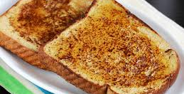

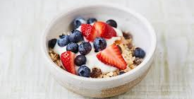
Breakfast
It is true that breakfast is the most important meal of the day.
Make sure your routine gives your child plenty of time to sit and eat, along with a drink.
Breakfast sets a child up for the day, improving their concentration and giving them the energy they need.
We know ourselves it is hard to concentrate when breakfast has been missed. It can make children have a lack of concentration, feel lethargic, irritable and not ready for learning.
Just like all food it is ok to have sugary cereals if it is in moderation. Remember to switch it up. Porridge is a great slow burner to feel full for longer. Toasts and fruit are great.
A sugar high intake in the morning is then followed by a sugar-low which will affect and impact your child’s mood and readiness for learning.

Slide 10

Timing
Whether it is getting to school or perhaps going to before school club, your child will appreciate knowing what time you are leaving the house.
Pre warnings really help to reduce anxiety and the feeling of being rushed in the morning. We are leaving in 10minutes, we are leaving in 5mins, it is time to leave.
Wake up at the same time, breakfast at the same time. That way, it becomes the routine and will make it harder to be late leaving the house. Try to keep it the same to provide consistency and predictability.
Do you yourself have a routine? What happens if you change it? How does this make you feel?

Slide 11
Any Questions???
This has been made in the hope to support our families and their little ones to have a healthy morning routine with the hope your child arrives at school, on time, happy and ready for learning.
If any of our families would like any further support around morning routines, please do get in touch with our SENCo Mrs Hawkes, our Pastoral Advisor Mrs Burton or Mrs Dennis from our Wellbeing In Mind Team Representative.

